Slide 1
Planning Presentation
Franklin Willemen, Qi Draaisma, Maura van der Linden, Lars Zandbergen & Celena Jordaan

Slide 2
Contents
Our Project
Vision
First Sprint
Second Sprint
Final Sprint
Questions

Slide 3
Our Project
Entrepreneur Challenge
Profitable Website

Slide 4

Vision
What: Artificial Intelligence project platform.
Who: AI Start-ups and engineers.
Why: One platform where AI talent and projects come together.

Slide 5
Contact with client
Monday
Project overview
Thursday
Planning review
TA
Wednesday

Slide 6
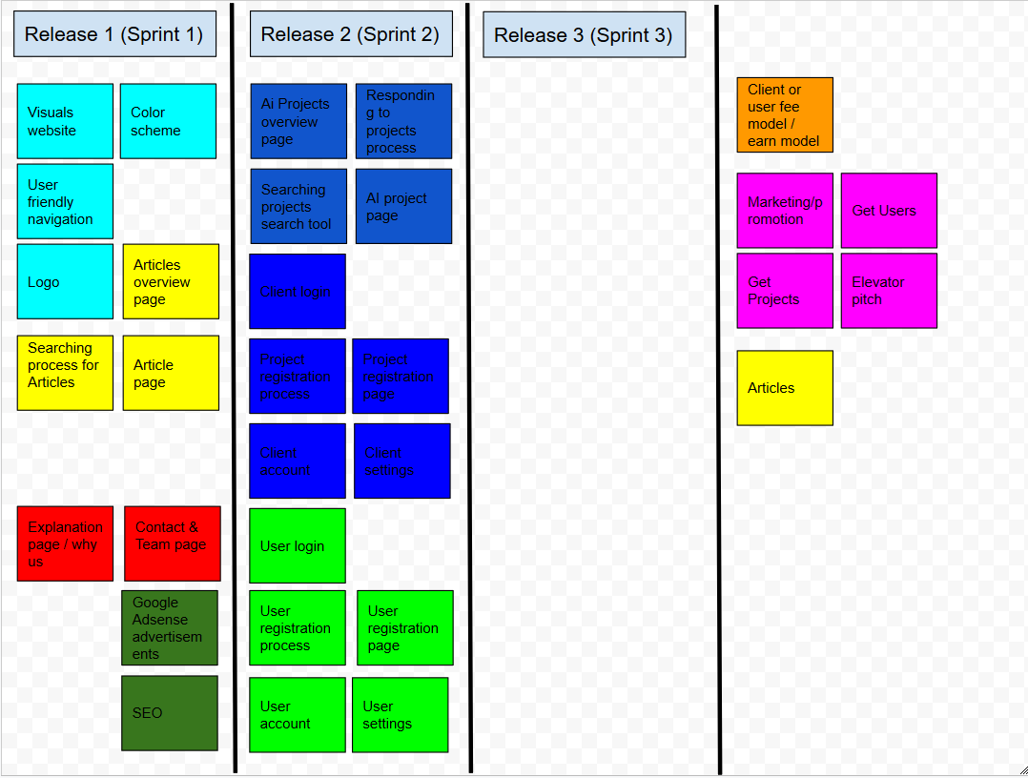
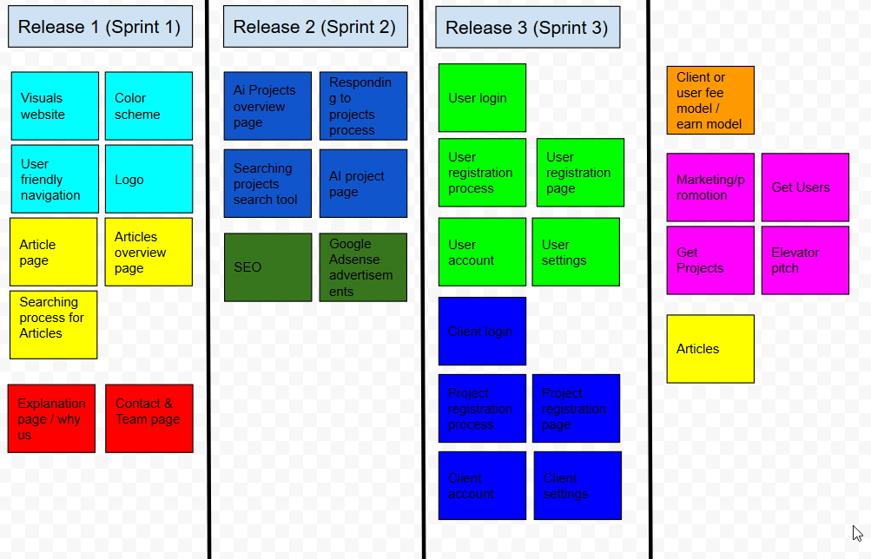
Revisions

Slide 7
Roadmap / Product Backlog
Website framework
large
Business and Informative Articles
medium
Adsense & SEO
medium
Project Marketplace
medium
Business Challenges
large
Business protocol
small
User Interface
medium

Slide 8
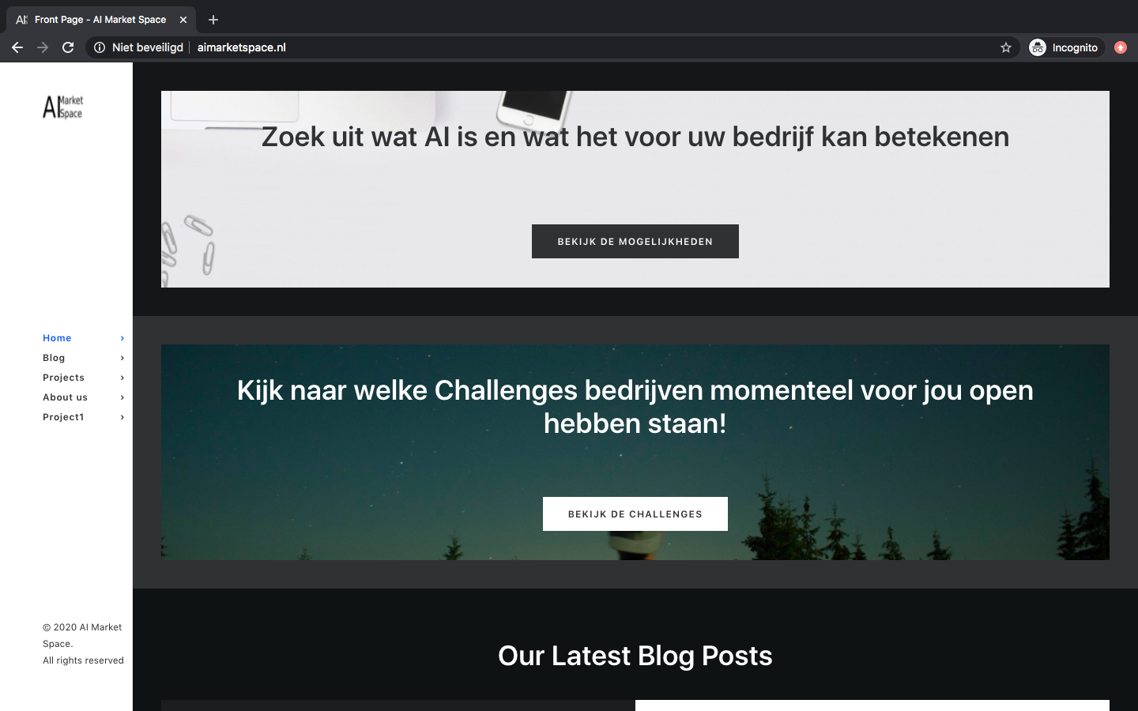
First Sprint
Website Framework
WordPress
Articles (Business & Informative)
SEO
Adsense
Notes:
People can access our website and see what AI can do for businesses and what it means.

Slide 9
Second Sprint
Project Marketplace
Interface
Reaction for engineers
Business Challenges
Contact start-ups
Application form
Notes:
During our second sprint we want to develop our plan further. As Franklin told you before our website must be able to show projects from different companies for freelancers to react to. The first step in this process is to create the project marketplace. There are multiple requirements for this marketplace. The first one is that it has to be shown as a list of different projects that companies have to offer. The second one is that the freelancer must be able to search through these different projects. And the last one is that when the user clicks on a project it shows more info and also the info on how the freelancer is able to contact the company that offers the project. The second step is to get different challenges on our website. To achieve this we want to contact different start-ups and ask if they are having projects available that they want to display on our site. When the first few project are online start-ups/companies and other users should be able to contact us through an application form, containing the information about their project, if they want to publish their project on our website.

Slide 10
Final Sprint
User Interface
AI experts
Start-ups
Business protocol

Slide 11
General overview
Sprint 1
Sprint 2
Sprint 3
Website framework
SEO & Adsense
Project Marketplace
Business Protocol
Business and informative articles
Business Challenges
User Interface

Slide 12
Questions

